Slide 1

INSTITUTE :UIE
DEPARTMENT: ACADEMIC UNIT 1&4
Bachelor of Engineering (Computer Science & Engineering)
Subject Name and Code:
Quantum and Semiconductor Physics Lab
20SPP-182
Prepared by: Ms. Sanjoli, Assistant Prof. Physics
DISCOVER . LEARN . EMPOWER
DOPPLER EFFECT

Slide 2
Importance of Advanced Engineering Physics
The electrical devices which are used as home appliances are based on physics rules and laws.
Automobile technology is based on the principle of thermodynamics.
Lasers are widely used in medical sciences.
Radar technology is based on the rules of Physics.
Nuclear energy is used on a large scale to produce electric power.

Slide 3
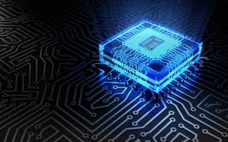
COURSE OBJECTIVES
To train engineering students in basics of measurements and the instruments.
To give practical training on basic Physics experiments which are useful to engineers.
To equip the students with practical knowledge in electronics and optics.
Figure 1 [1]

Slide 4
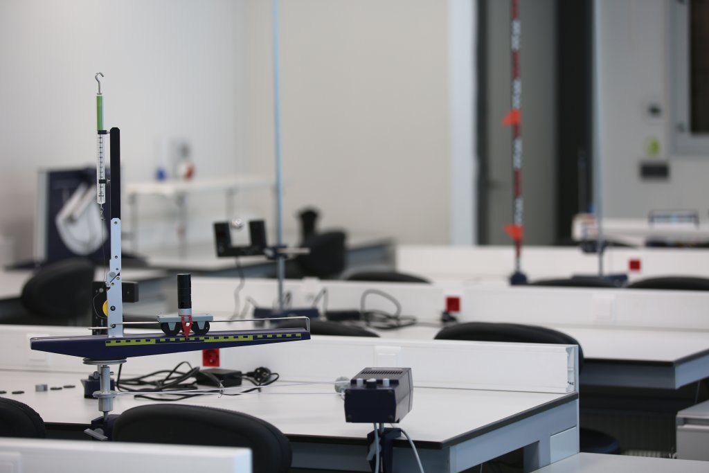
COURSE OUTCOMES
CO Number | Title On completion of this course, the students are expected to learn | Level
CO1 | It will provide the modest experience that allows students to develop and improve their experimental skills and develop ability to analyze data. | Understand Applying Analyze
CO2 | Ability to demonstrate the practical skill on measurements and instrumentation techniques of some Physics experiments. Students will develop the ability to use appropriate physical concepts to obtain quantitative solutions to problems in physics. | Understand Applying Analyze
CO3 | Students will demonstrate basic experimental skills by setting up laboratory equipment safely and efficiently, plan and carry out experimental procedures, and report verbally and in written language the results of the experiment. | Understand Applying Analyze
Figure 2 [2]

Slide 5
LIST OF EXPERIMENTS
To determine the Hall Voltage and Hall Coefficient Using Hall Effect.
To determine the resistivity of semiconductors by four probe Method.
To draw the static current- voltage characteristics of a Zener diode.
To calculate the frequencies at constant intensity for material using photoelectric effect.
To determine the diffraction using LASER beam and find the grating element of diffraction grating.
To determine the numerical aperture of optical Fiber.
To find the divergence of LASER beam.
Determination of ‘h’ using photocell.
To find the velocity of ultrasonic wave in the given liquid.
Investigating the Doppler Effect with ultrasonic waves.

Slide 6
Objective
The objective of this lab activity is to calculate change in frequency of sound emitted by source moving relative to observer using Doppler Effect.

Slide 7
Apparatus Required
S.No. | Equipment | Quantities in No.
1 | Source | 1
2 | Detector/Observer | 1

Slide 8
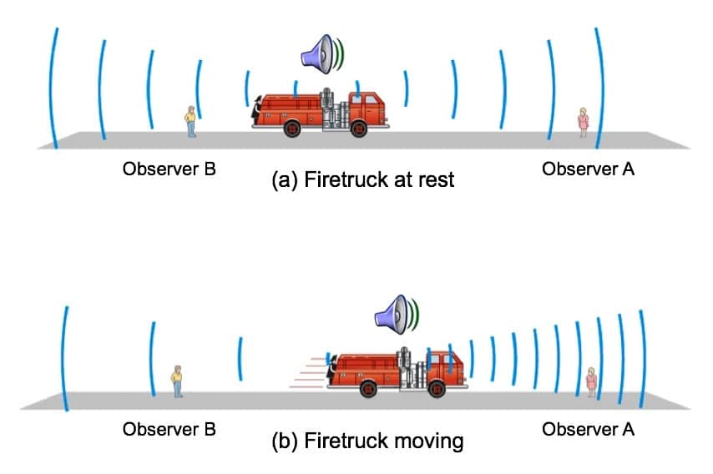
Doppler Effect
Doppler Effect is the change in frequency of electromagnetic waves due to the relative motion between source and observer.
Figure 3 Doppler Effect

Slide 9
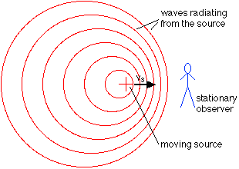
Source and Observer
The Doppler Effect can be described as the effect produced by a moving source of waves in which there is an apparent upward shift in frequency for observers towards whom the source is approaching and an apparent downward shift in frequency for observers from whom the source is receding.
Figure 4 Source and Observer

Slide 10
Theory
The effect was first observed by Christian Doppler in 1842.
The effect is used to measure velocities usually by reflection of a transmitted wave from the moving objects like galaxies (red shift), radar for speeding cars and thunderstorms, etc.
It is commonly observed when a vehicle with sounding a siren approaches, passes and recedes from an observer.
As the source moves toward the observer, there forms a compression of waves between the source and the observer reducing its length which in effect increases the frequency.

Slide 11
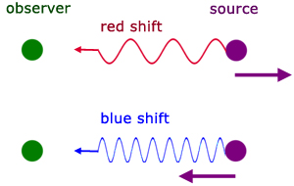
Theory
The Doppler Effect for light waves is commonly expressed in terms of colours rather than frequency.
A red shift occurs when the source and observer are moving away each other .
A blue shift occurs when the source and observer are moving towards each other.
Figure 5: Red and blue shit

Slide 12
Formula used
Moving towards the source f = f₀ ( v + v₀ )/ (v – v _{s} ) (1)
Moving away from source f = f₀ ( v - v₀ )/ (v + v _{s} ) (2)

Slide 13
Procedure
Click the start button.
Click on the drop down combo box for selecting the medium.
Select the detector direction and source direction from the drop down combo box.
The velocity of the source and observer are adjusted by clicking on the slider.

Slide 14
Procedure
The frequency of the source is adjusted by clicking on the slider.
The detected frequency can be calculated using the equation (1).
The reset button reset all the default values.
The user can do the experiment with another set of values.

Slide 15
Observation Table
S.No. | Direction | Source velocity v _{s}(m/s) | Detector velocity v₀(m/s) | Source frequency f₀(Hz) | Detected frequency f(Hz)
1 | Moving towards the source
2 | Moving away from source

Slide 16
Calculation
Select medium : Air/Glass/Steel/Water
Select source direction: Left/ Right
Select receiver direction: Left/ Right
Moving towards the source f = f₀ ( v + v₀ )/ (v – v _{s} )
Moving away from source f = f₀ ( v - v₀ )/ (v + v _{s} )

Slide 17
Result
Detected frequency f (Hz) =_________ Hz

Slide 18
Learning Outcomes
On completion students will be able to understand
The observed frequencies of a sound changes with the velocities of the source and the observer.
When source and observer are moving towards, the observer hears a frequency higher than the source frequency.
When they move away each other, the observer hears a frequency lower than the source frequency.

Slide 19
Summary
Introduction to Doppler Effect
Description of Equipments.
Observation table.
Result

Slide 20
References
[1] https://images.app.goo.gl/onXTfVDfo1WiwTcK9
[2] https://in.pinterest.com/pin/842243567793191631/
[3] https://hearinghealthmatters.org/waynesworld/files/2016/11/Figure-2.jpeg
[4] http://buphy.bu.edu/~duffy/PY105/34b.GIF
[5] http://a-levelphysicstutor.com/images/waves/dopp-redshift01.jpg

Slide 21
Simulation and video links
Simulation Link:-
https://vlab.amrita.edu/?sub=1&brch=201&sim=368&cnt=2
Link for related video: -
https://youtu.be/VcwZ3N9anzc
https://youtu.be/vDvIhiCnatE

Slide 22
THANK YOU
For queries:Sanjoli.e8737@cumail.in

